Slide 1
Variables in C
Mohamed Rahman Shareff s

Slide 2
Variables
It is a name given to a storage area/Memory location that our programs can manipulate.
Unlike constant, variables are changeable, we can change value of a variable during execution of a program
Each variable in C has a specific type, which determines
the size and layout of the variable's memory;
the range of values that can be stored within that memory and
the set of operations that can be applied to the variable.

Slide 3
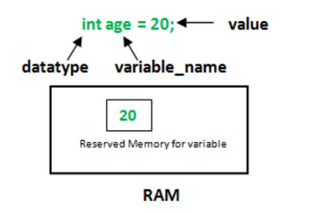
Datatype of Variable
A variable in C language must be given a type, which defines what type of data the variable will hold.
It can be:
char: Can hold/store a character in it.
int : Used to hold an integer.
float: Used to hold a float value.
double: Used to hold a double value.
void

Slide 4
1. Declaring a Variable
Declaration of variables must be done before they are used in the program
Declaration does the following things.
It tells the compiler what the variable name is.
It specifies what type of data the variable will hold.
Until the variable is defined the compiler doesn't have to worry about allocating memory space to the variable.
Declaration is more like informing the compiler that there exist a variable with following datatype which is used in the program.
A variable is declared using the extern keyword, outside the main() function.
extern int a; extern float b; extern double c, d;

Slide 5
Declaring a Variable
Syntax for variable declaration:
Datatype variable_name;
Example for variable declaration:
int a;
float b;
char c
Multiple variables can be declared with one statement, like this:
Example: int a, b,c;

Slide 6
Assigning values to variable
After declaring variables, you can assign a value to a variable later on using a statement like this:
Syntax:
datatype variable_name;
Variable_name=value
Example: int a;
a=10;

Slide 7
Assigning values to variable
You can also assign a variable the value of another variable
Ex: int a , b;
a=b
2. Assign multiple variables the same value with one statement:
Ex: int x=y=z=10

Slide 8
Initialization
Declaring a variable and assigning a value at the declaration time called initializing a variable..
Initialization = Declaration + Assignment in a single step.
Ex: int a=10;-------→ Initialization
int x=50,y=90,z=80;

